Slide 1
Big Data Platform
Lessons Learned in Growing a Big Data Capability for Network Defense

Slide 2
Who am I?
Technical Director, Enlighten IT Consulting, a MacAulay-Brown company
Software Engineering Consultant
Helped found Apache Rya
Chief Architect of DoD’s Big Data Platform
Currently working for:
Defense Information Systems Agency (DISA)
Army Cyber Command
US Cyber Command
Center for Army Analysis
Air Force

Slide 3
Talk Overview
DCO Big Data Problem Space
DoD’s Big Data Platform
Scaling for Big Data
Multi-Tenancy
Lessons Learned

Slide 4
Problem Space
Huge variety of DCO sensors
Heterogeneous data formats
No enterprise standardization on infrastructure
Petabyte scale storage/retention/analysis requirements
No single “out of the box” COTS, GOTS, or OSS solution by itself meets the unique DoD cyber security challenges
Enabling collaborative investigation while eliminating redundant efforts

Slide 5
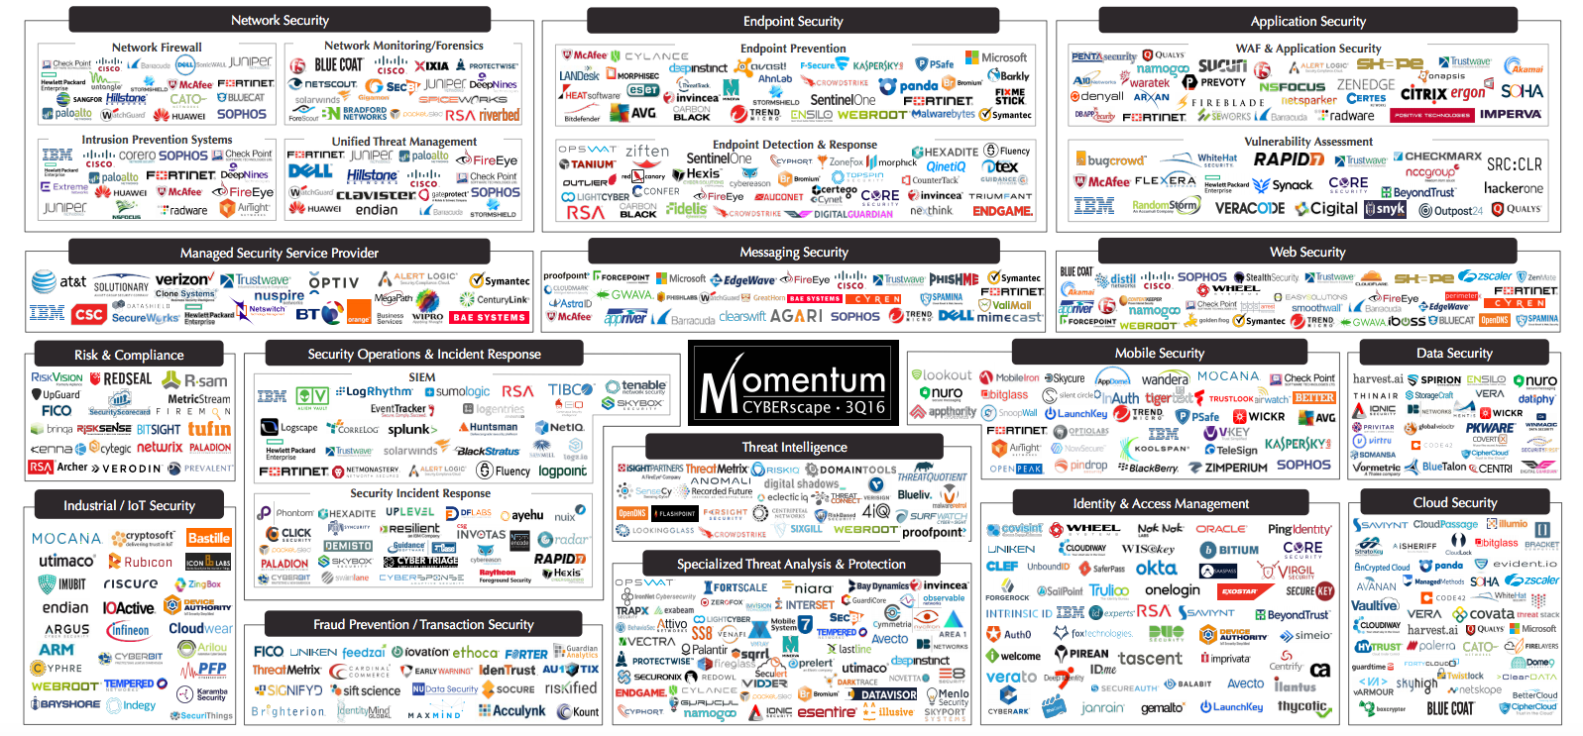
Problem Space

Slide 6
What is the BDP?
A cloud-based distributed architecture for ingesting and storing large datasets, building analytics, and visualizing the results.
Allows critical decisions to be made based on rich and broad data.
Developed around open source and unclassified components while leveraging community tech transfer from other DoD entities.
DISA-controlled software baseline
RMF accredited with current Authority To Operate in multiple organizations
99% open source, specifically integrated to meet DoD’s needs

Slide 7
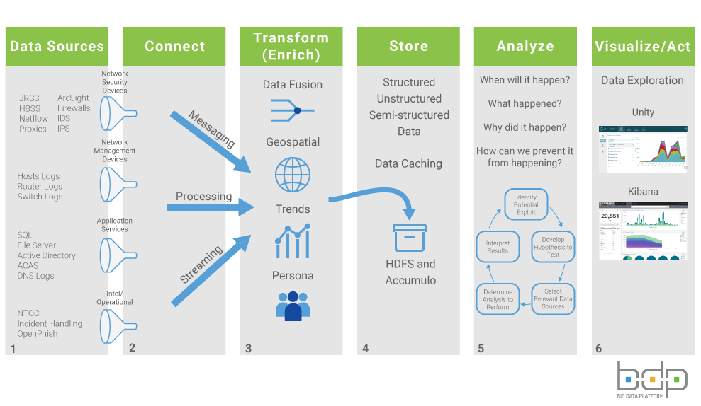

Slide 8
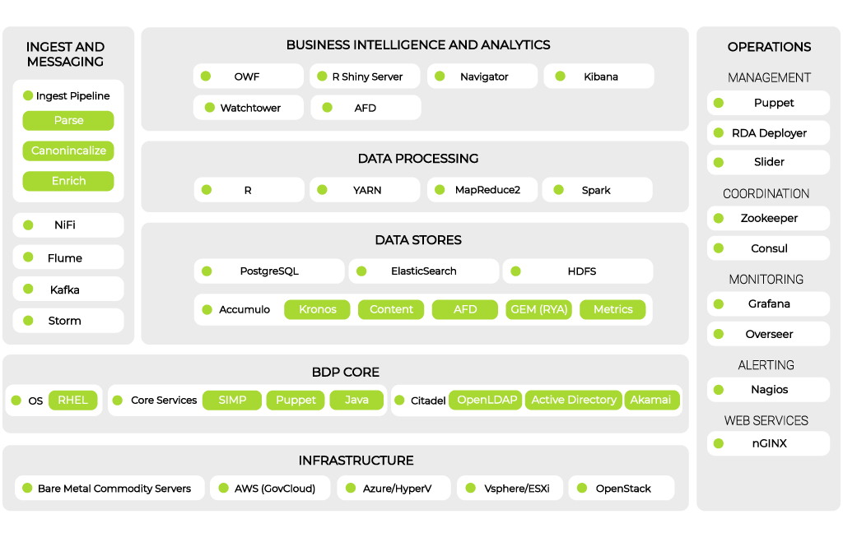
Big Data Platform Technology Stack

Slide 9
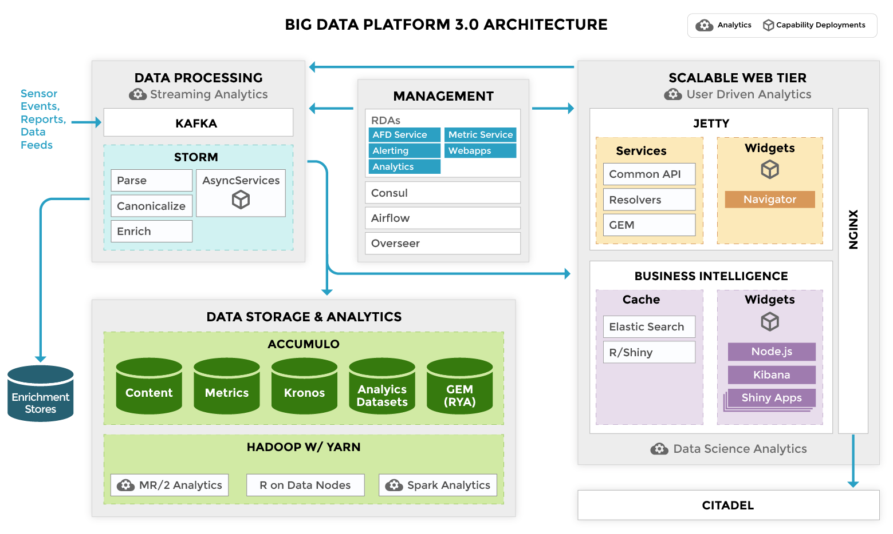

Slide 10
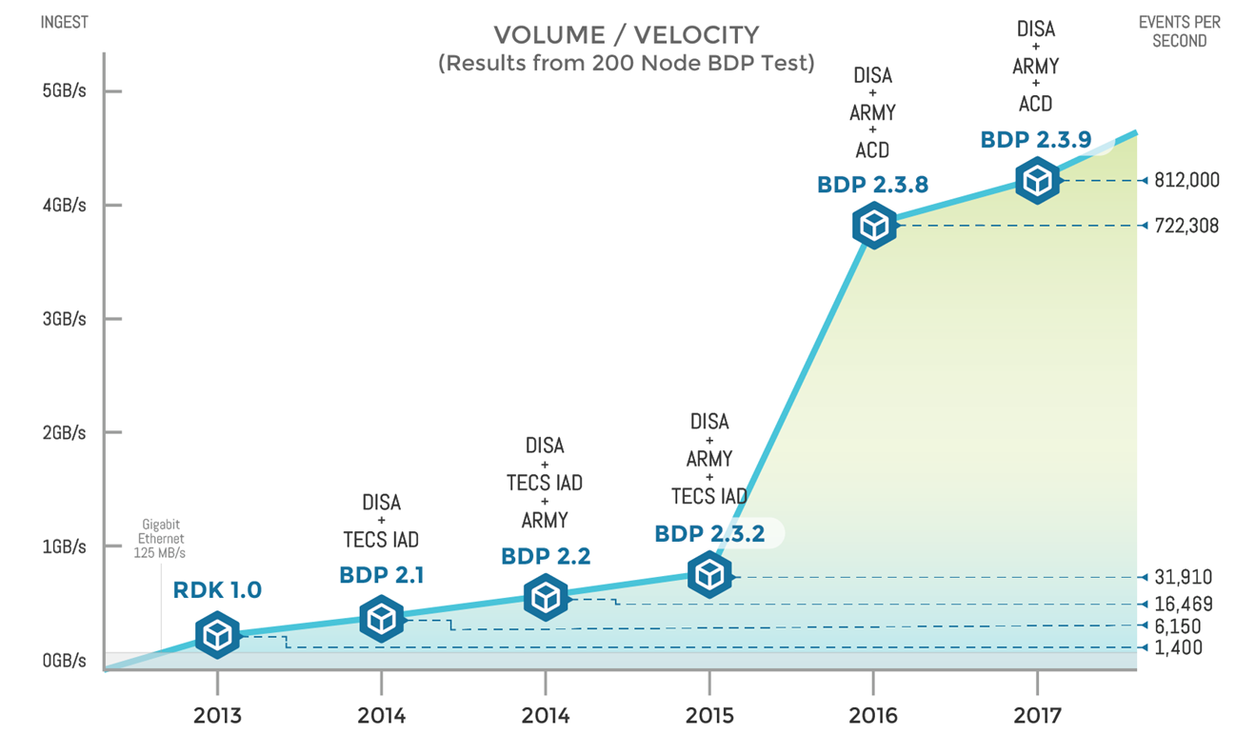
Scaling for Volume and Velocity

Slide 11
Multi Tenancy (Learning to share)
HDFS / Accumulo (Storage)
Analytics
Spark
Streaming- Kafka/Storm
RShiny
Web Applications
Jetty
NodeJS
Microservices
Spring/Java/NodeJS
Ingest

Slide 12
Lesson Learned:
It’s all about the data
Don’t underestimate the difficulty of collecting and sharing data
End user analytic questions have to drive data priorities
You can’t wait to start collecting data until you need to use it
*Just enough* normalization will allow unplanned correlations to emerge
Data from many vantage points increases the value (but analysts need to understand the vantage point of each)

Slide 13
Lesson Learned:
Use commercial cloud infrastructure
It lets your engineering teams focus on your problems not on infrastructure
It provides “just in time” capacity that reduces costs in the long run
It has a refresh rate that is much more frequent than traditional in-house data centers
It reduces barriers for data transport and acquisition

Slide 14
Lesson Learned:
Standardize your platform early, but evolve it
Organizations can share security accreditation
Shared data structures will encourage correlations
Be willing to change and evolve, without reinventing everything every time
Create and document APIs that encourage reuse
Leverage a community to share costs

Slide 15
Lesson Learned:
Analytics need to scale
Need to run on commodity hardware (if you can fit all your data into memory, you don’t have big data)
Need to be parallelizable
Need to handle preemption (half your job may be killed at any moment to make way for higher priority tasks)
Need to be secure (can’t open ports, store passwords; need to handle data security controls)

Slide 16
Lesson Learned:
You need to optimize your load
Use batch ingest
Cache data near the web tier
Adjust the allocation of resources to your mission (YARN is great, but it needs to be managed)
Test with real world datasets (size and variety)
Understand the computational costs of your analytics before deploying them

Slide 17
Questions?

